Slide 1

AI GOVERNMENT SCHEME ELIGIBILITY
Foundations of Artificial Intelligence – Project Presentation
JATHIN CHOWDARY C H (240701209)
Guided by Mrs B. Deepa | Assistant Professor (SG) | Dept of CSE
StudyForge AI | Foundations of Artificial Intelligence 1

Slide 2
Problem Statement & Objectives
Develop an AI-powered system to recommend suitable government schemes based on citizens’ profiles and eligibility criteria.
Simplify eligibility checking using details such as age, income, occupation, location, and social category, where relevant.
Provide clear information about scheme benefits, eligibility requirements, required documents, and application procedures.
Reduce the time and effort required to search for relevant government schemes.
Integrate reliable government scheme information through cloud-based functionality while supporting a local demonstration or fallback mode.
Provide a user-friendly, responsive interface that improves awareness and access to government welfare schemes.
StudyForge AI | Foundations of Artificial Intelligence 2

Slide 3
Proposed System & Technology Stack
Proposed System
Technology Stack
Unified student dashboard
Study Library + Study Kit
Quiz + Flashcards + Progress
Planner + StudySync
CodeLab programming practice
React 18 + TypeScript + Vite
Node.js + Express
Supabase Auth + PostgreSQL
Groq API through protected backend
Wandbox compiler for CodeLab
StudyForge AI | Foundations of Artificial Intelligence 3

Slide 4
Major Functional Modules
User Registration and Profile Management
Manages user accounts and collects relevant details such as age,
income, occupation, location, and other scheme-specific information.
Government Scheme Database
Stores government scheme information
AI-Based Eligibility Checker
Checks eligibility for schemes.
Scheme Recommendations
Suggests suitable government schemes
Document Checklist
Lists required application documents
Admin Management
Updates and manages scheme information
StudyForge AI | Foundations of Artificial Intelligence 4

Slide 5
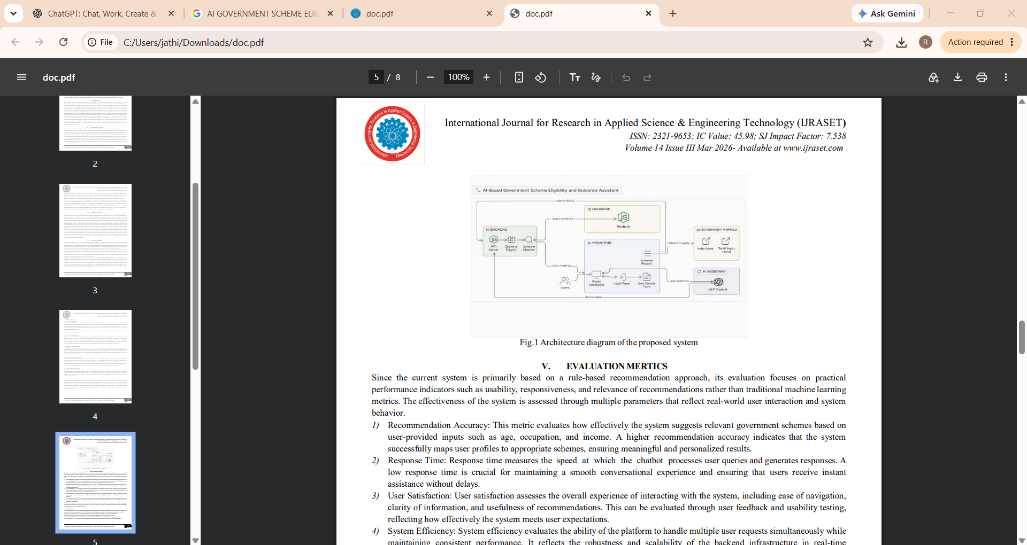
StudyForge AI | System Architecture 5

Slide 6
AI Integration & Learning Workflow
Collects user details such as age, income, and occupation.
Stores user profile information securely.
Retrieves relevant government scheme data.
Analyzes user details using AI.
Matches profiles with scheme eligibility criteria.
Identifies potentially eligible government schemes.
Recommends suitable schemes to users.
Explains scheme benefits and eligibility conditions.
Provides required document lists and application links.
Displays results through a user-friendly dashboard.
C
StudyForge AI | Foundations of Artificial Intelligence 6

Slide 7
Database, Security & Implementation
The AI Government Scheme Eligibility Advisor uses a database to store user profiles, government scheme details, eligibility criteria, benefits, and application procedures. Security features such as user authentication, access control, data encryption, and input validation protect sensitive information. AI integration analyzes user details and matches them with suitable government schemes. The system provides personalized recommendations, required document checklists, and official application links. Implementation includes designing a user-friendly interface, connecting the database, integrating AI functionality, and testing the system. Regular maintenance and scheme updates help ensure accurate information, reliable performance, and improved access to government welfare benefits for eligible citizens.
StudyForge AI | Foundations of Artificial Intelligence 7

Slide 8
Testing, Results & Discussion
The AI Government Scheme Eligibility Advisor was tested to evaluate its functionality, accuracy, security, and usability. User registration, profile management, scheme searching, and eligibility checking were tested successfully. The AI recommendation module matched user details with relevant government scheme criteria and displayed suitable schemes. The system also provided scheme benefits, required documents, and application links. Input validation and authentication helped improve data security. Testing showed that the system could simplify scheme discovery, reduce manual searching, and improve user awareness of government benefits. However, recommendation accuracy depends on the availability and regular updating of scheme information.
StudyForge AI | Foundations of Artificial Intelligence 8

Slide 9
Limitations & Future Enhancements
Current Limitations
Future Enhancements
The system depends on updated scheme data and internet access. AI recommendations may not always be accurate, and real-time application tracking may be unavailable for certain government schemes.
Future enhancements include multilingual support, improved AI accuracy, real-time scheme updates, mobile application development, automated document verification, personalized notifications, and integration with official government portals for better accessibility and user experience.
StudyForge AI | Foundations of Artificial Intelligence 9

Slide 10
Conclusion & References
The AI Government Scheme Eligibility Advisor helps users identify suitable government schemes based on their personal details and eligibility criteria. It simplifies scheme discovery by providing benefit information, required documents, and application guidance. The system improves awareness, saves time, and makes government welfare information more accessible. Future improvements can enhance accuracy, accessibility, and integration with official government services.
References
National Portal of India – Government schemes and services.
myScheme Portal – Government scheme discovery and eligibility information.
Digital India – Digital government initiatives.
Ministry of Electronics and Information Technology – Digital governance and technology initiatives.
UMANG Portal – Access to government services.
OpenAI Documentation – AI integration and API development.
Thank You
StudyForge AI | Foundations of Artificial Intelligence 10

